Slide 1
Employee data analysis using excel
STUDENT NAME : Lavanya. C
REGISTER NO : asunm110312201357
DEPARTMENT : B. Com(Genral)
COLLEGE : Dharmamurthi Rao Bahadur Calavala Cunnun Chetty Hindu College.

Slide 2
PROJECT TITLE
Employee Data Analysis Using Excel

Slide 3
AGENDA
Problem Statement
Project Overview
End Users
Our Solution And Proposition
Data Set Description
Modelling Approach
Results And Diuscussion
Conclusion

Slide 4
PROBLEM STATEMENT
A problem statement is a short, clear explanation of an issue or challenge that sums up what you want to change. It helps you, team members, and other stakeholders to focus on the problem, why it's important, and who it impacts.

Slide 5
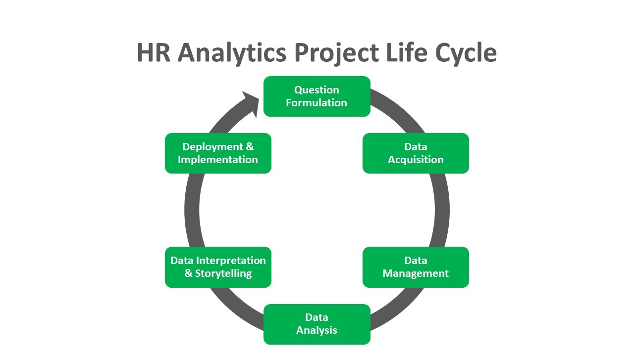
Project Overview

Slide 6
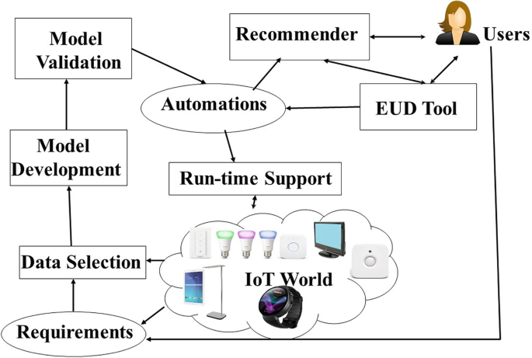
End users
Manager Only , Employee-ManagerEmplyloyecuCustomer

Slide 7
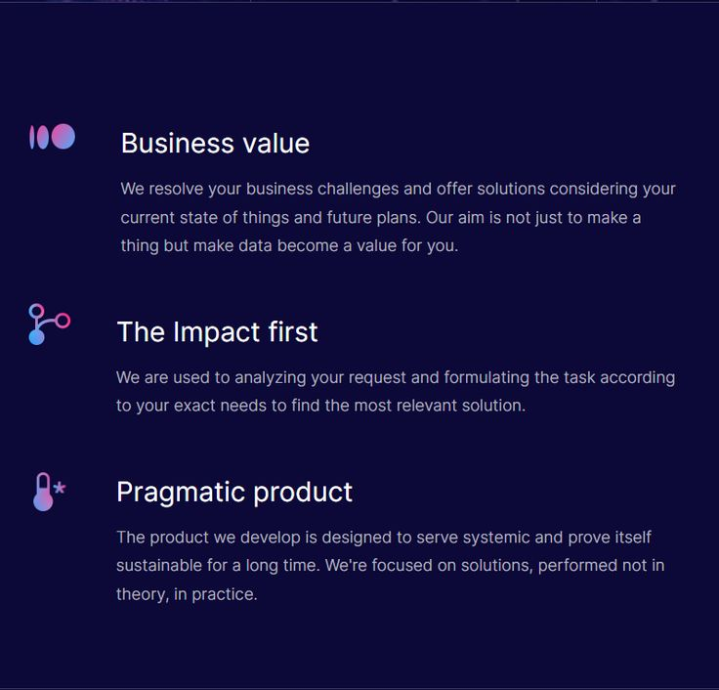
Our solutions and propositions:

Slide 8
Dataset description:
Name | Gender | Department | Salary
Jesicca | Female | Marketing | 30000
Harry | Male | Engineering | 50000
Lalisa | Female | Training | 100000
Hermione | Female | Services | 70000
Revi | Male | Support | 52000
Sandria | Female | Business Development | 75000
Daisie | Female | Marketing | 33000

Slide 9
Data set description
A Dataset is a set or collection of data. This set is normally presented in a tabular pattern. Every column describes a particular variable. And each row corresponds to a given member of the data set, as per the given question. This is a part of data management.

Slide 10
Modelling approach
I get data from dashboard employee data analysis. And brief about the problem statement and project overview what to do and accurate information about the projectoverwview.And end users are where it was started and where it was ended ..our solution and prospostion are solution the project . It is the profit motivate and satisfied the employee wants and needs .

Slide 11
Results and discussion
Result:
Row Labels | Fixed Term | Permanent | Temporary | Grand Total
Business Development | 75000 |  | 102000 | 177000
Engineering |  | 130000 |  | 130000
Marketing | 119000 | 30000 | 33000 | 182000
Services | 45000 | 118000 | 72000 | 235000
Support |  | 161000 |  | 161000
Training |  | 167000 | 56000 | 223000
Grand Total | 239000 | 606000 | 263000 | 1108000

Slide 12
Conclusion:
Now I conclude the presentation Improve hiring and talent acquisition: Data analytics can help recruiters find professionals with the right skills and qualifications.
Employee strengths are important because they can affect performance, motivation, and retention. According to the strengths-based approach, focusing on and developing the strengths of your employees can lead to greater productivity and quality, higher engagement and satisfaction, and lower turnover and absenteeism

Slide 13
Thank you

